Slide 1
CSE 471: MACHINE LEARNING
Word2Vec

Slide 2
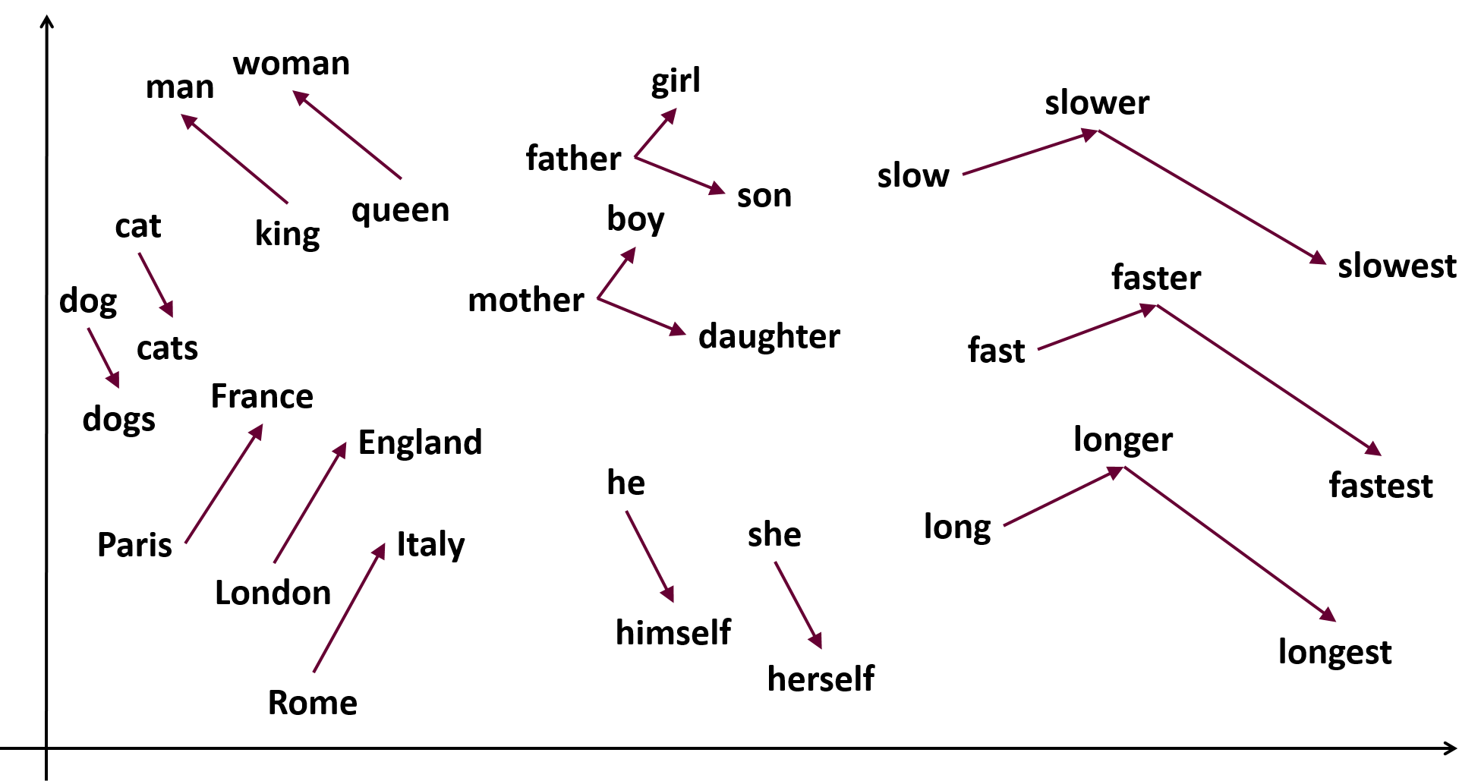
Word embedding (Word2vec)
Image taken from: https://samyzaf.com/ML/nlp/nlp.html

Slide 3
Word embedding (Word2vec)
Train a model whose parameters are the word vectors
Two algorithms
  Continuous Bag-of-Words (CBOW)
    Predict a center word from the surrounding context
  Skip-gram
    Predict the distribution (probability) of context words from a center word.
Negative sampling
  Defines an objective by sampling negative examples

Slide 4
Continuous Bag of Words Model (CBOW)
Treat {"The", "cat", "over", "the", "puddle"} as a context
From the context, the model should be able to predict or generate the center word "jumped"
For each word, we learn 2 vectors
  Input vector v when the word is in the context
  Output vector u when the word is in the center

Slide 5
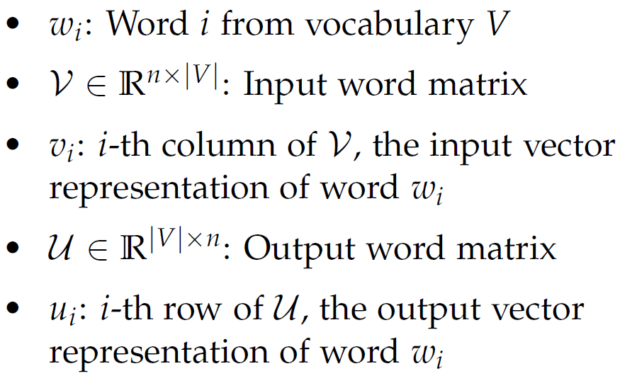
Notation for CBOW Model

Slide 6
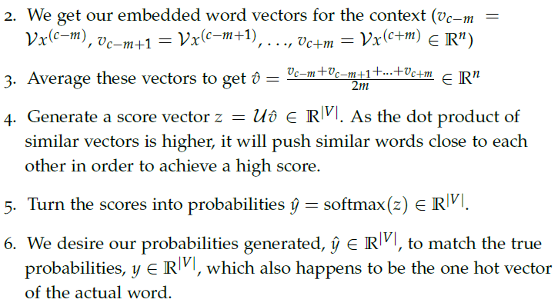
CBOW model - Steps

Slide 7
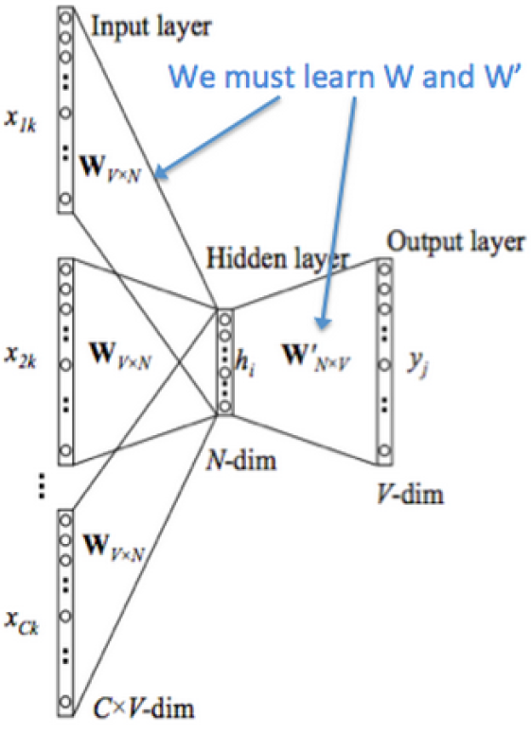
Continuous Bag of Words Model (CBOW)
This image demonstrates how CBOW works and how we must learn the transfer matrices

Slide 8
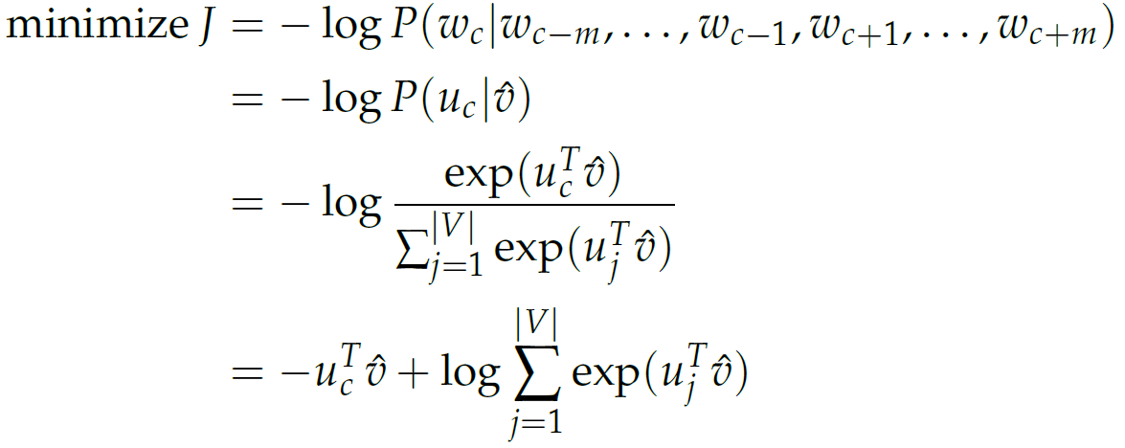
Optimization Objective
We use stochastic gradient descent to update all relevant word vectors u_{c} and v_{j}

Slide 9
Skip-Gram Model
Given the center word "jumped", the model will be able to predict or generate the surrounding words "The", "cat", "over", "the", "puddle".

Slide 10
Notation for Skip-Gram Model

Slide 11
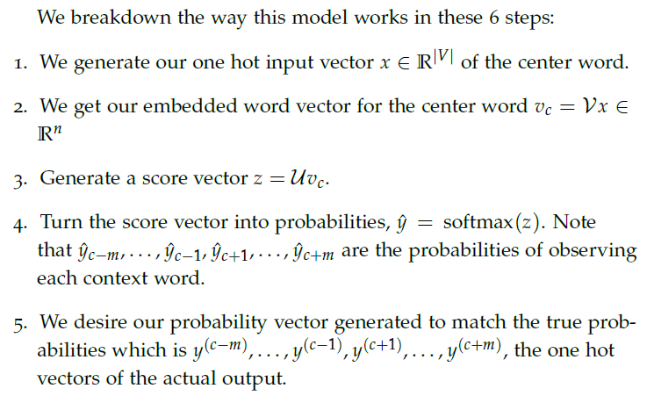
Skip-Gram Model - Steps

Slide 12
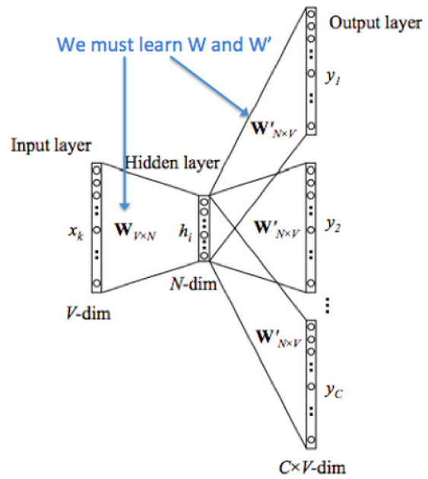
Skip-Gram Model
This image demonstrates how Skip-Gram works and how we must learn the transfer matrices

Slide 13
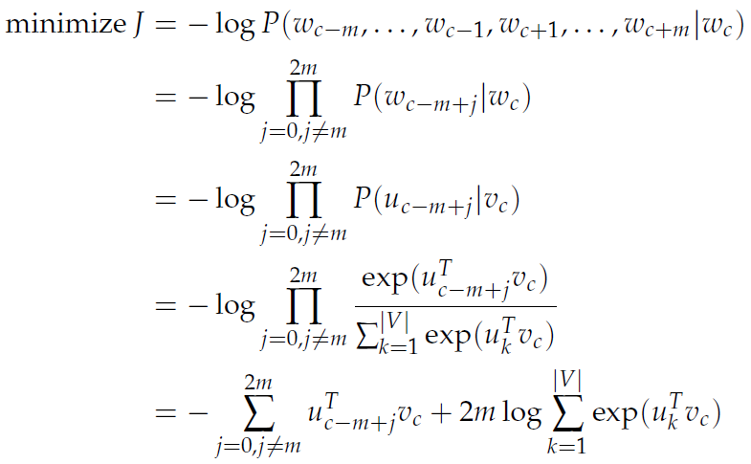
Optimization Objective

Slide 14
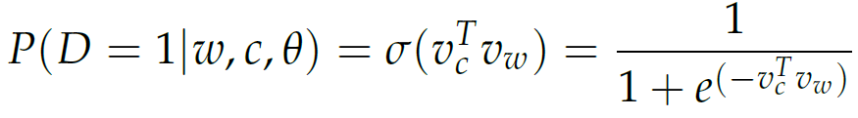
Negative Sampling
Sample from a distribution P_{n}(w)
Let (w, c) be a pair of word and context
P(D = 1|w, c) – probability that (w,c) came from corpus data
  Modeled with sigmoid function
P(D = 0|w, c) – probability that (w,c) did not come from corpus data

Slide 15
New Objective
Maximize the probability of a word and context being in the corpus data
  If it indeed is
Maximize the probability of a word and context not being in the corpus data
  If it indeed is not.
We take a simple maximum likelihood approach of these two probabilities.

Slide 16
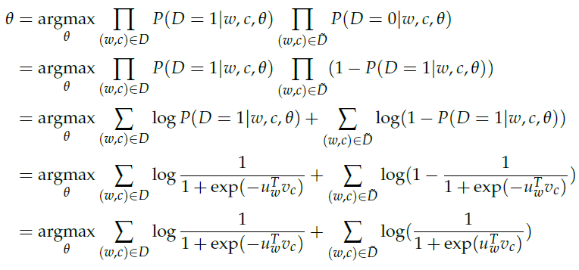

New Objective

Slide 17



New Objective
For skip-gram, our new objective function for observing the context word c - m + j given the center word c would be
For CBOW, our new objective function for observing the center word u_{c} given the context vector

Slide 18

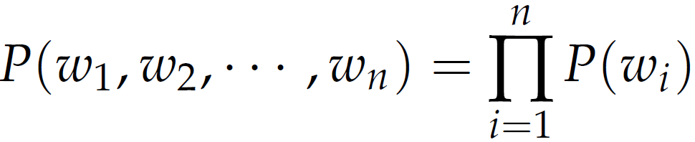
“Negative” corpus
Can be generated on the fly
  Randomly sample from the word bank.
Unigram Model
  Raised to the power of ¾.
Unigram Model

